Slide 1
CSR Week TBS
By Anand Krishna Goyal
Youth Ambassador,
‘Libraries For All’ Initiative

Slide 2
Why is Community Service Important?
New perspective and learning from the community around you.
Teamwork - work with peers, community members, local authorities
Communication skills - convince people of your idea, express your plan and understand the beneficiaries needs.
Leadership and decision-making skills - Planning, Organising and assessing the situation.
Teaches practical and problem solving skills

Slide 3
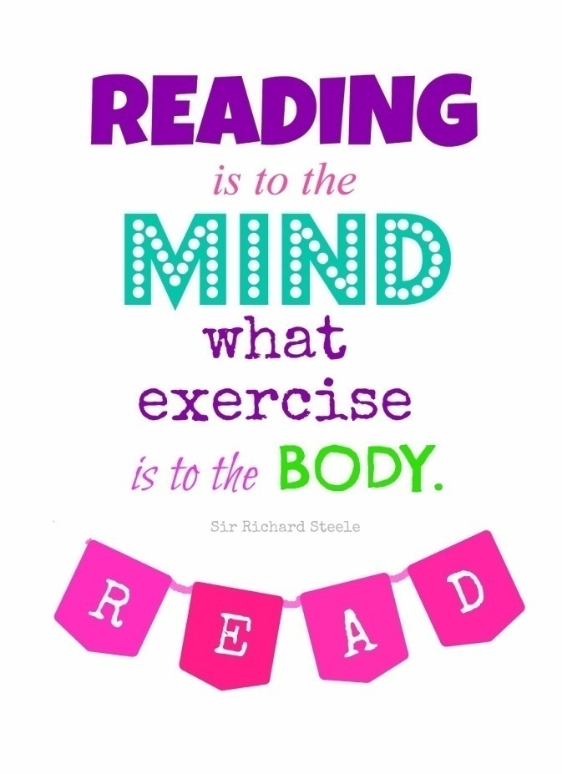
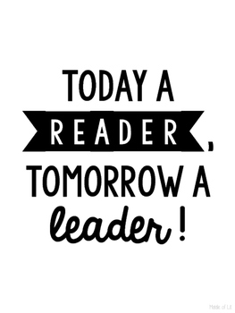
The Importance of Reading
Imagine if you could not read road signs
Imagine of you could not comprehend what you read in the newspaper
Imagine if you could not express your thoughts
Teaching young children to read helps them develop their overall language and communication skills.

Slide 4
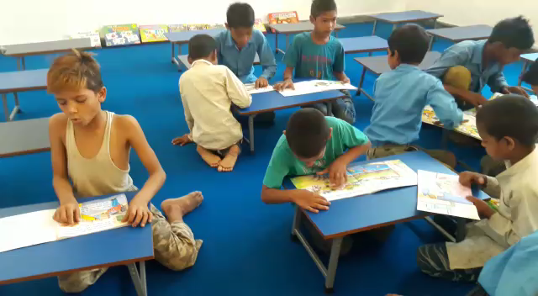
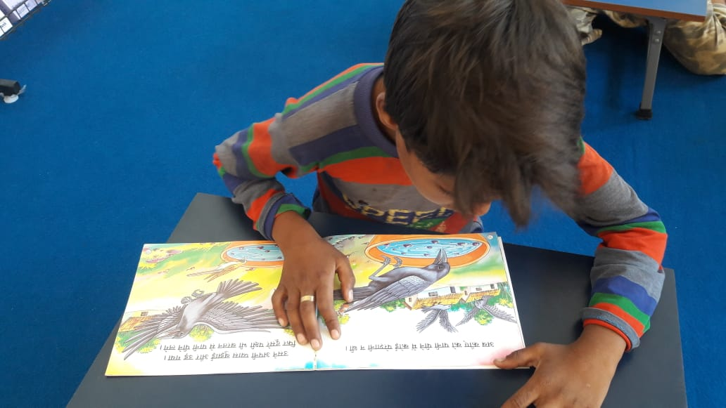
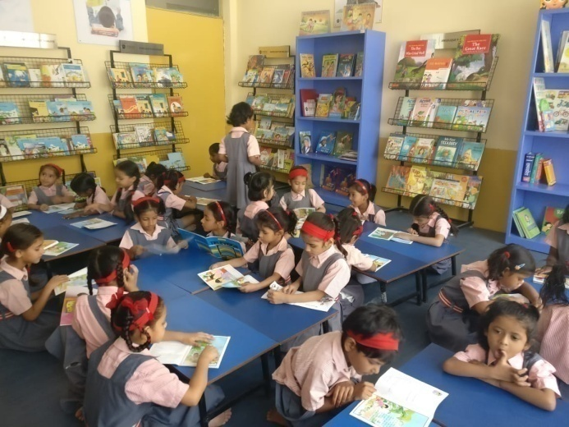
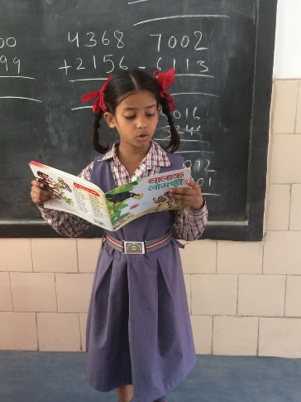
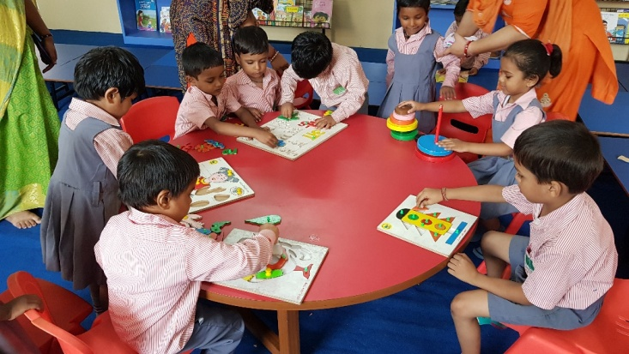
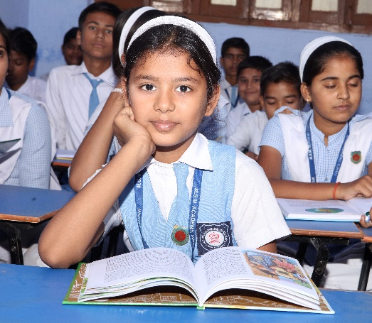
Bad libraries build collections, good libraries build services, great libraries build communities.
–R. David Lankes
To build up a library is to create a life. It’s never just a random collection of books.
–Carlos María Domínguez

Slide 5
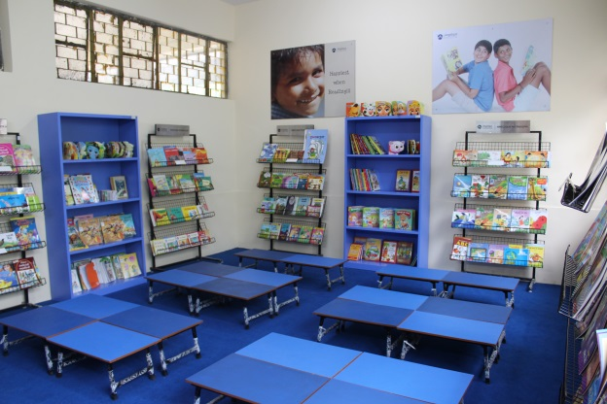
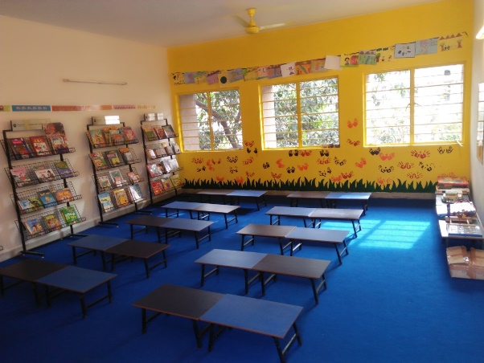
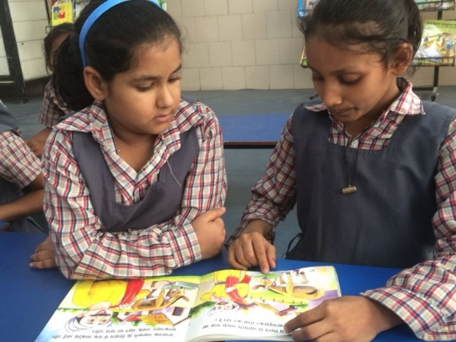
Why libraries..
to create a love for reading, enhance comprehension skills, creativity and encourage critical thinking.
to provide age appropriate books with large fonts, less text and colourful illustrations to support reading for all levels.
to create a comfortable and attractive environment that motivates children to read with minimum adult intervention.

Slide 6
The Need
Given the emphasis placed on reading in schooling, literacy levels are incredibly low.
According to the ASER 2016 report, that collected data from 589 rural districts of India,
In Class V, only one out of every four students could read a English sentence.
Students don’t have access to books and resources that promote comprehension and curiosity.
Notes:
MAKE PRETTY

Slide 7
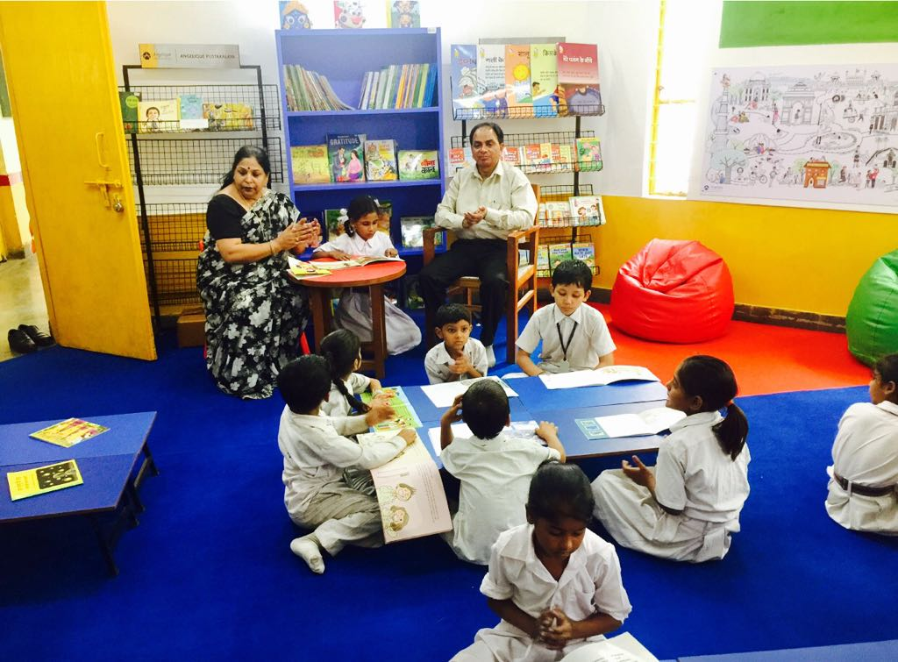
How we built libraries in
low income group schools
Notes:
How to Build-A-Library
Over the last X years, we have built 10 libraries at various low-income schools across the nation. We hope to foster a culture of volunteers and partners who are all working towards this same goal and are able to spread our work!

Slide 8
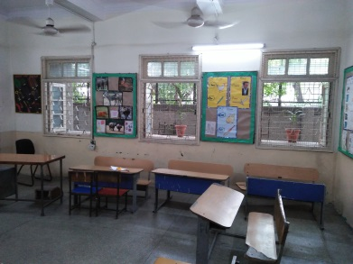
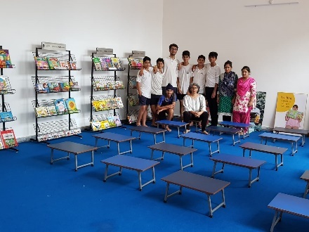
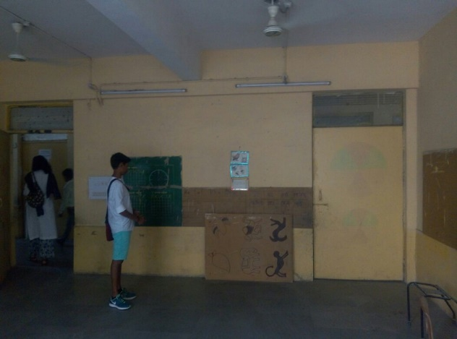
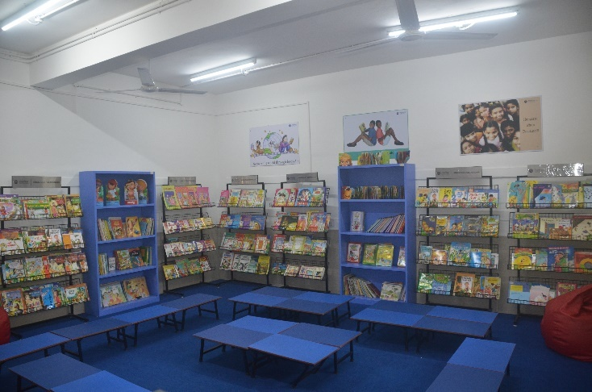
Our Work
BEFORE
AFTER

Slide 9
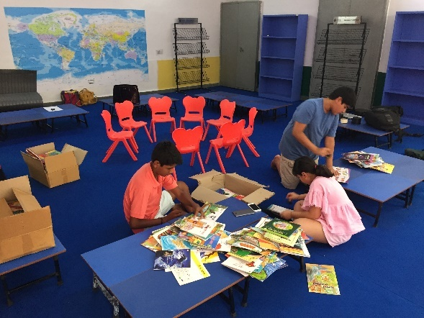
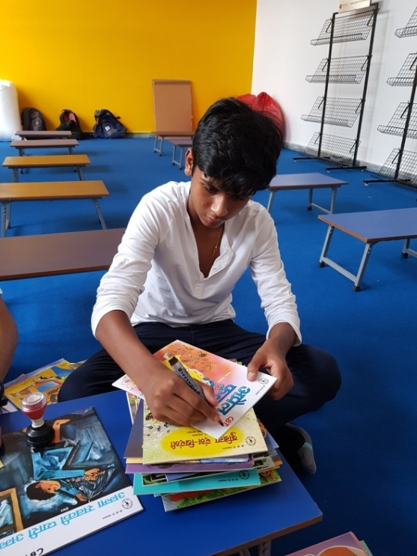
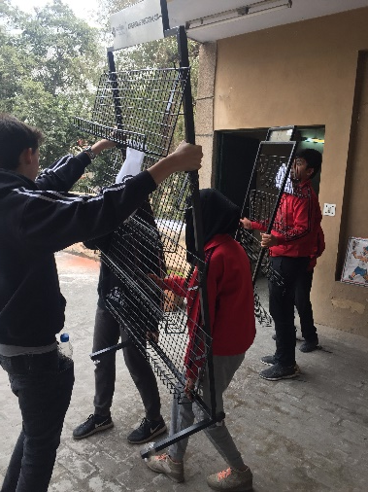
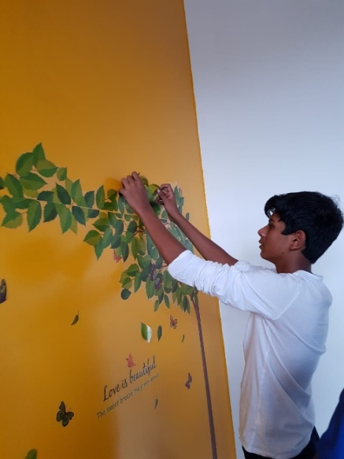
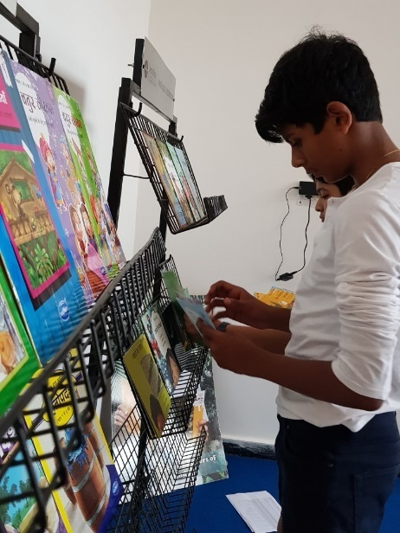
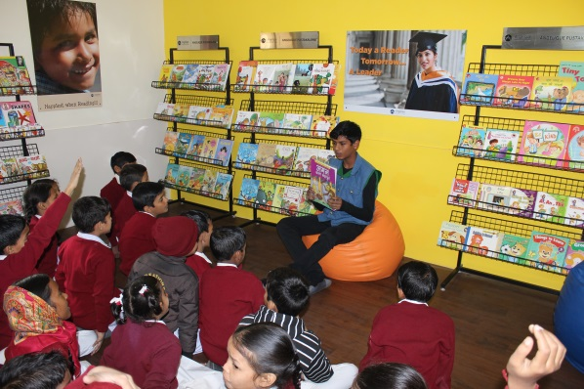
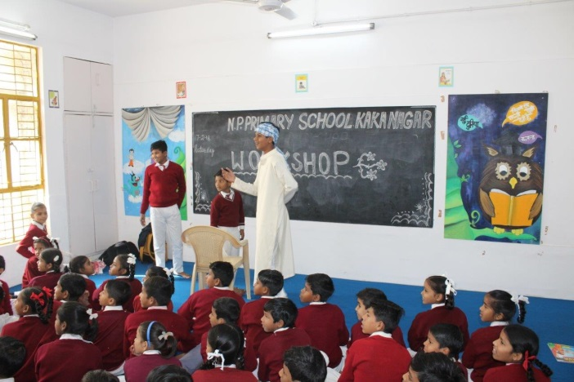
How we do it

Slide 10
Some Advice...
Be punctual
Interact with the children
Be sensitive and kind
Work hard with your team
Build long lasting relationships with the authorities
Have fun!!

Slide 11
THANK YOU! Feel free to ask any questions!!
Notes:
Thank You! Please feel free to contact us at EMAIL with any questions you may have. We hope to have you as part of the ‘Build-A-Library’ program.

